Slide 1
Process to update skill and upload CV

Slide 2
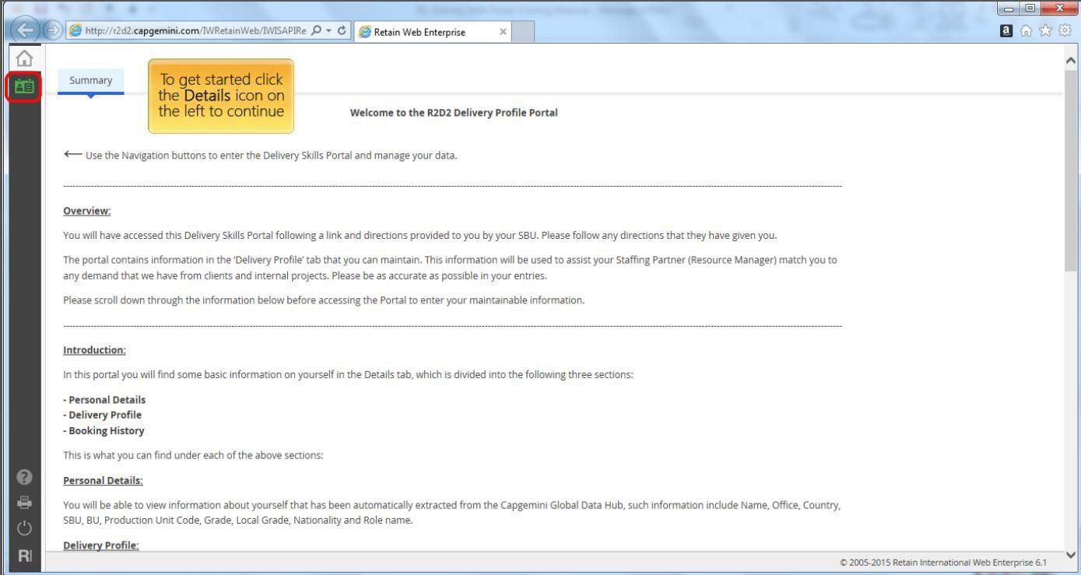
Skill Update
Every employee needs to be enter their skills in the Organization Skill database.
Enter the following link in the Chrome browser
r2d2.capgemini.com/IWRetainWeb/IWISAPIRedirect.dll/Files/static/html/webportal.html
Since it is Single sign-on you will be logged in and can update your profile. Click on Details

Slide 3
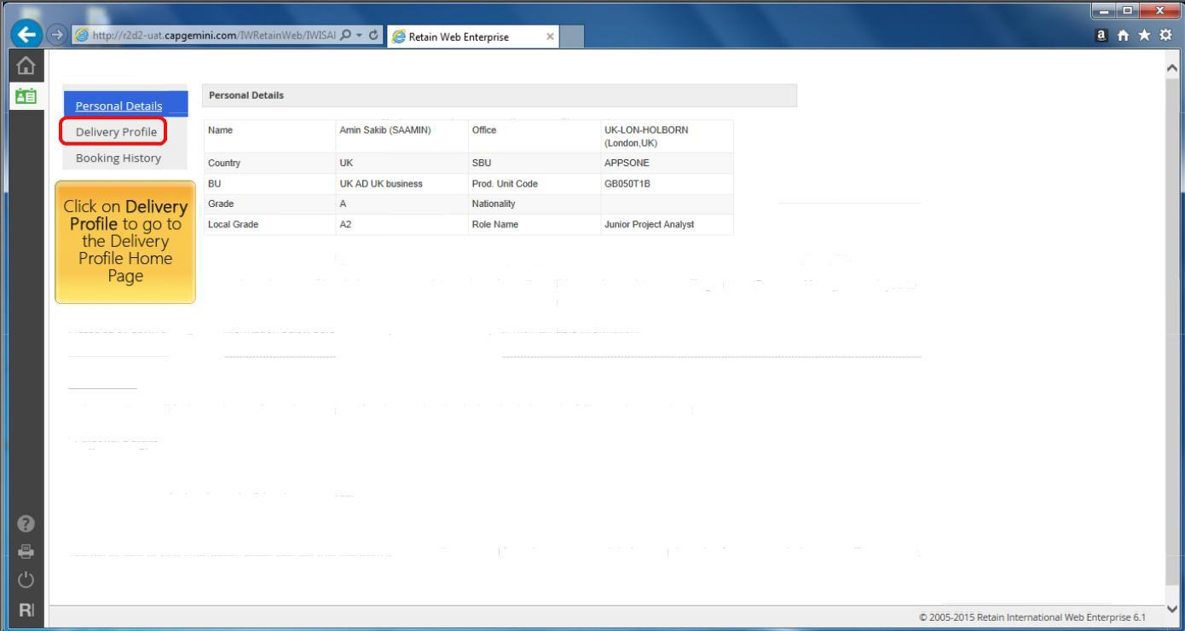
Skill Update
You will see your details displayed on screen
Click on Delivery Profile

Slide 4
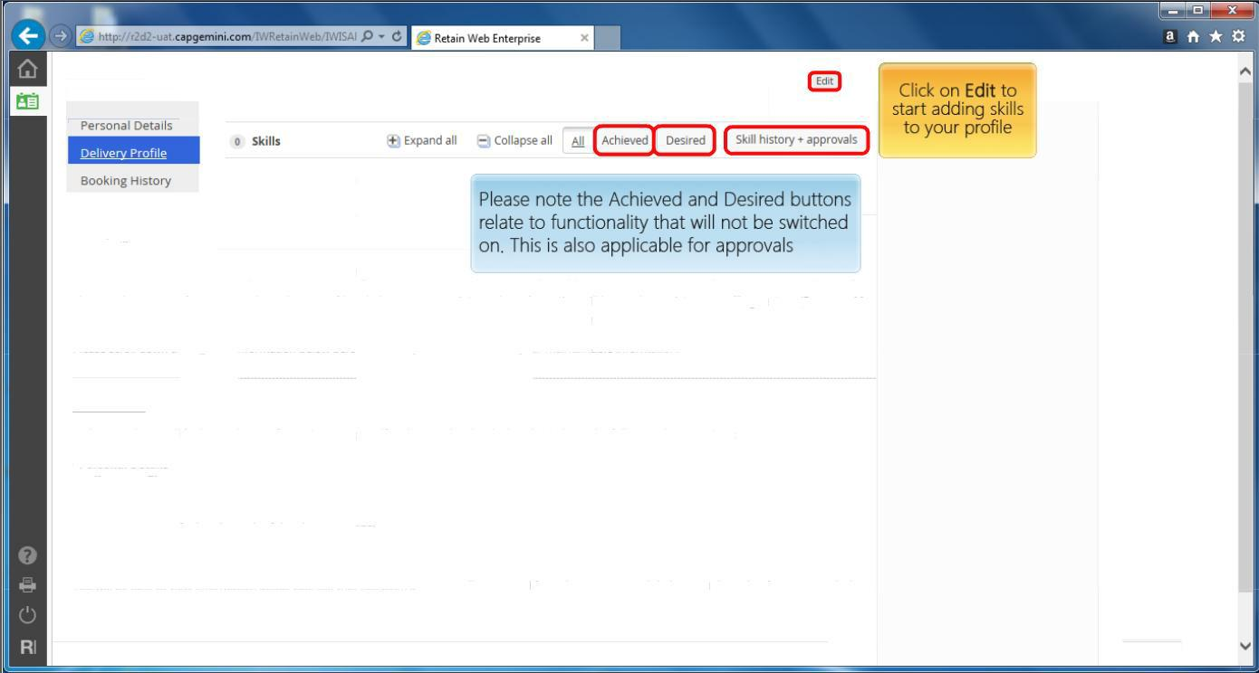
Skill Update
Click on Edit

Slide 5
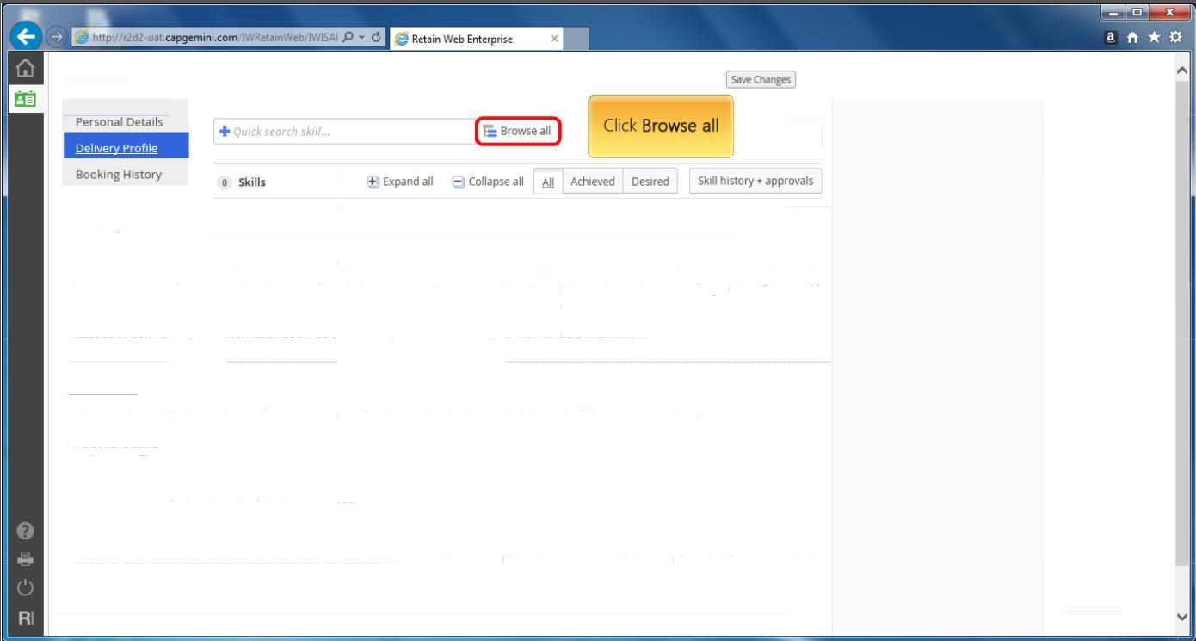
Skill Update
Click on Browse All

Slide 6
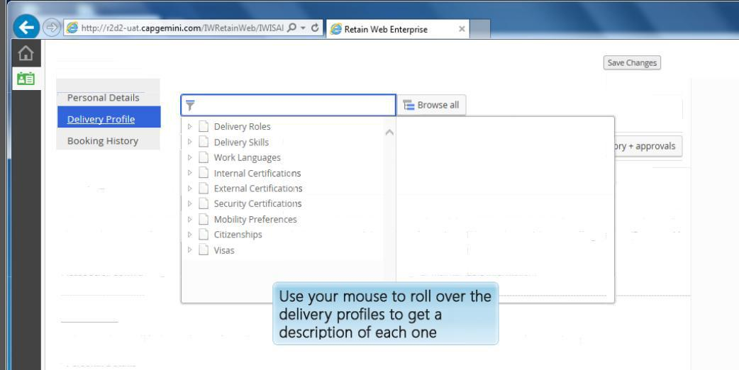
Skill Update
In Skill Portal you can enter the skills you possess, roles you have worked and certifications.

Slide 7
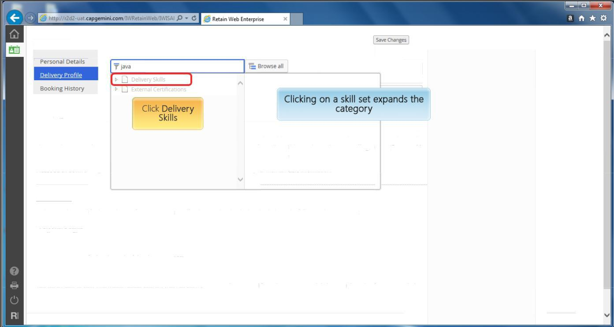
Skill Update
Since we doing Skill updates Select Delivery Skills

Slide 8
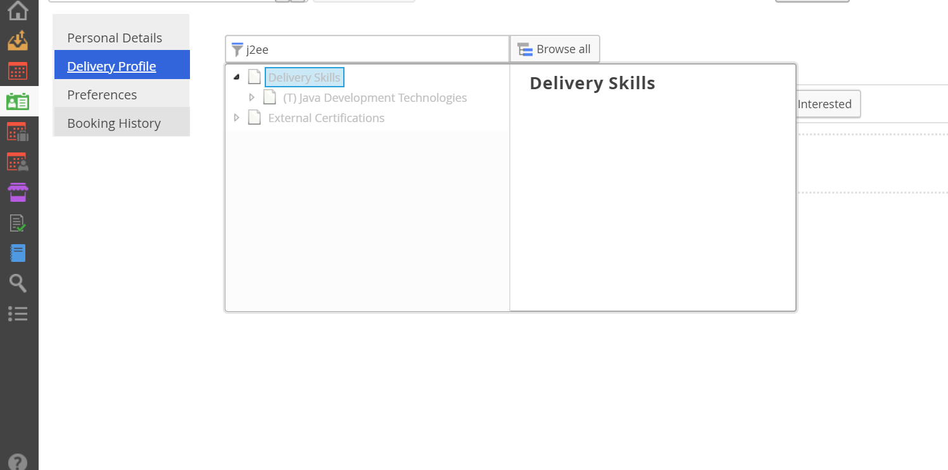
Skill Update
Based on the training attended , search the skill mentioned in the table to the right
Click on arrow to see the Skill hierarchy.
Training Attended | Skill to be searched & entered
Java | J2EE
.NET | C#
.NET | .Net (WF)
Manual Testing | Testing Manual
Automated testing | Selenium
RDBMS | Oracle DB PL/SQL
Informatica | Informatica BI
BO | Business Objects Reporting
DataStage | IBM Datastage
Ab Initio | Ab Initio
Unix Shellscript | Unix Shellscript
SAP/ABAP | SAP ABAO
Sap basis | SAP BASIS
Systems | C++/Unix
Mainframe | COBOL/CICS
Mainframe | VSAM
AS400 | COBOL/400
AS401 | RPG IV

Slide 9
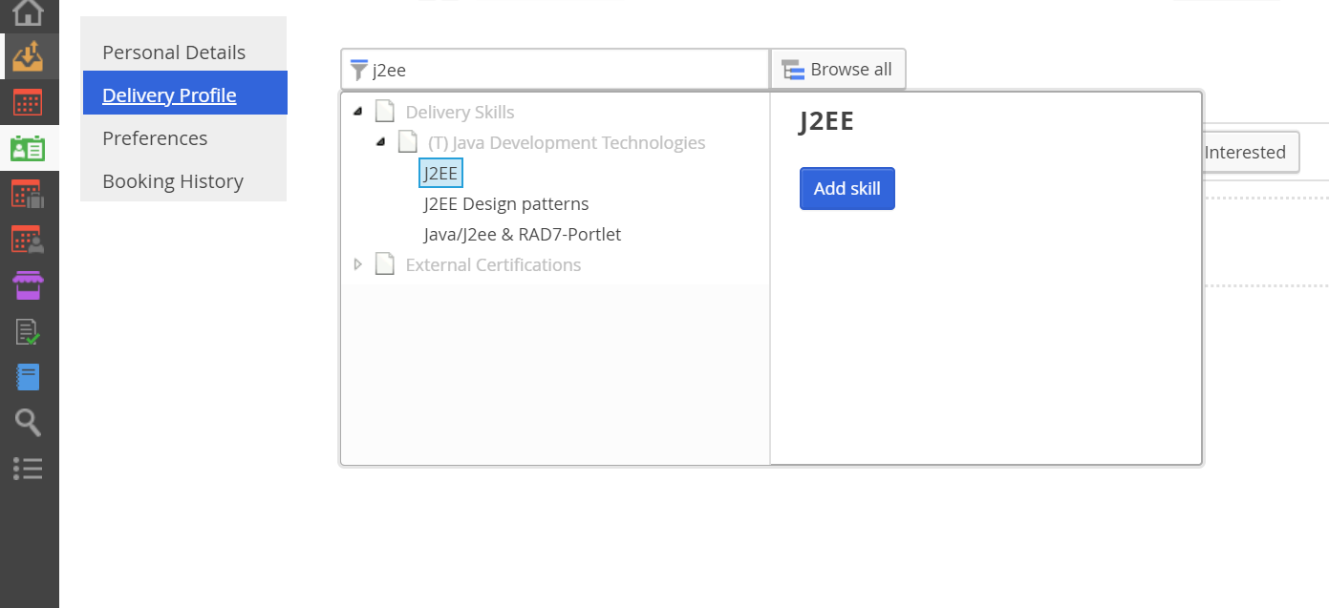
Skill Update
Select the skill as per the training attended Click on Add Skill
Training Attended | Skill to be searched & entered
Java | J2EE
.NET | C#
.NET | .Net (WF)
Manual Testing | Testing Manual
Automated testing | Selenium
RDBMS | Oracle DB PL/SQL
Informatica | Informatica BI
BO | Business Objects Reporting
DataStage | IBM Datastage
Ab Initio | Ab Initio
Unix Shellscript | Unix Shellscript
SAP/ABAP | SAP ABAO
Sap basis | SAP BASIS
Systems | C++/Unix
Mainframe | COBOL/CICS
Mainframe | VSAM
AS400 | COBOL/400
AS401 | RPG IV

Slide 10
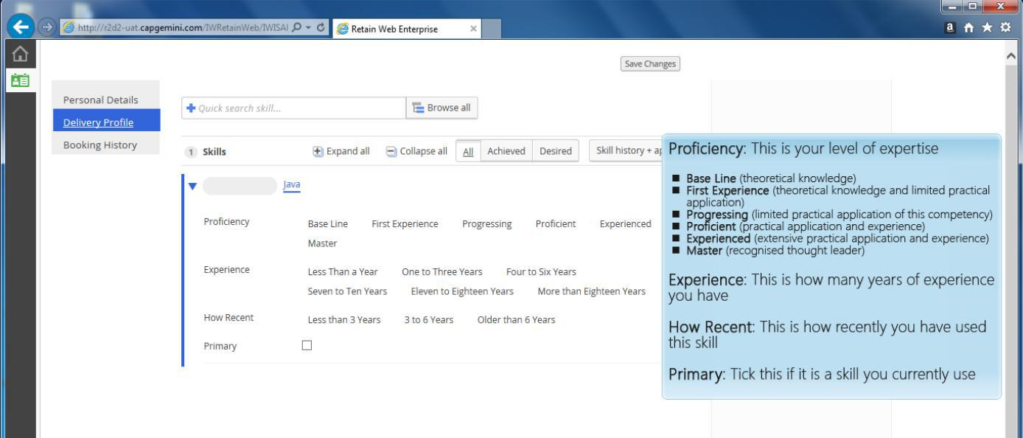
Skill Update
Enter the details as requested
Proficiency – First experience
Experience – Less Than a Year
How recent – Less than 3 years
Click on Primary

Slide 11
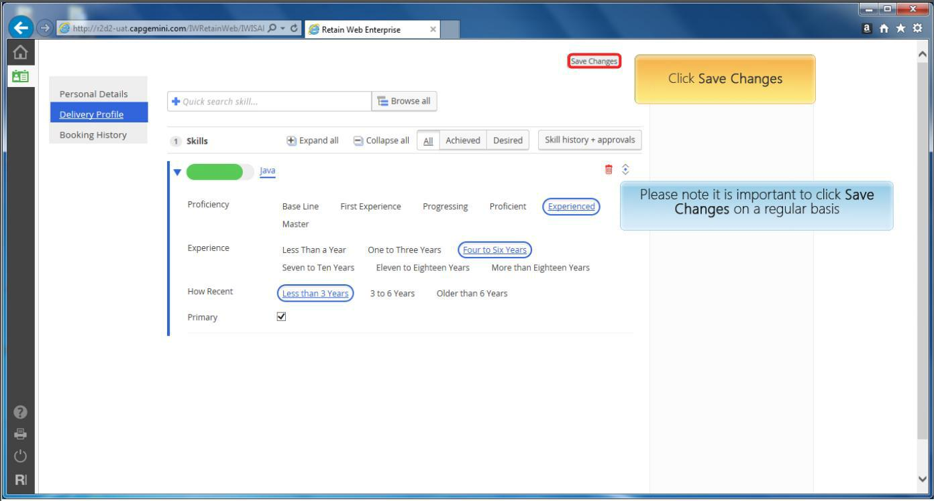
Skill Update
Once details are entered click on Save changes

Slide 12
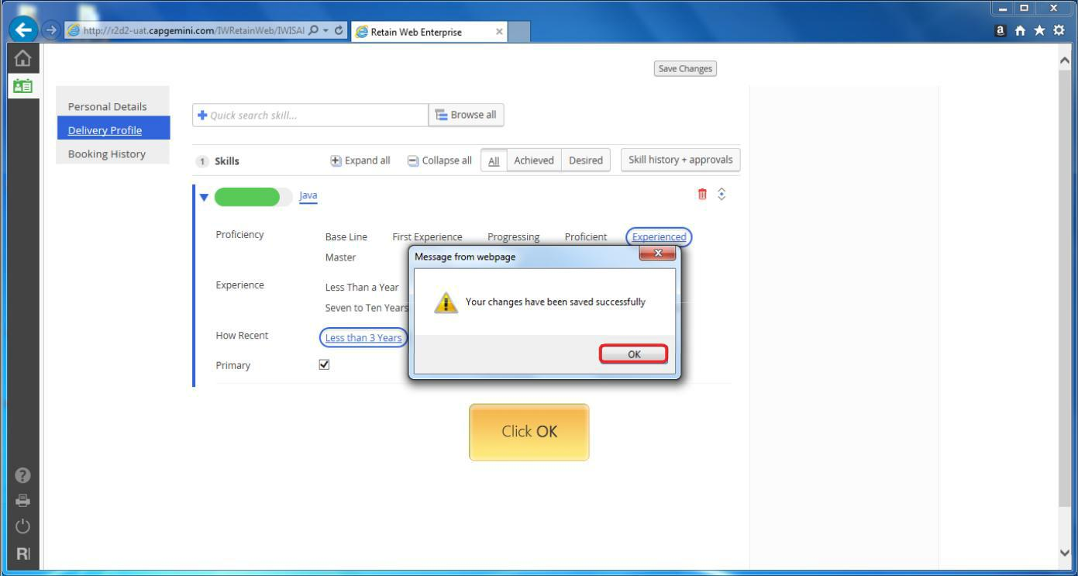
Skill Update
Click OK

Slide 13
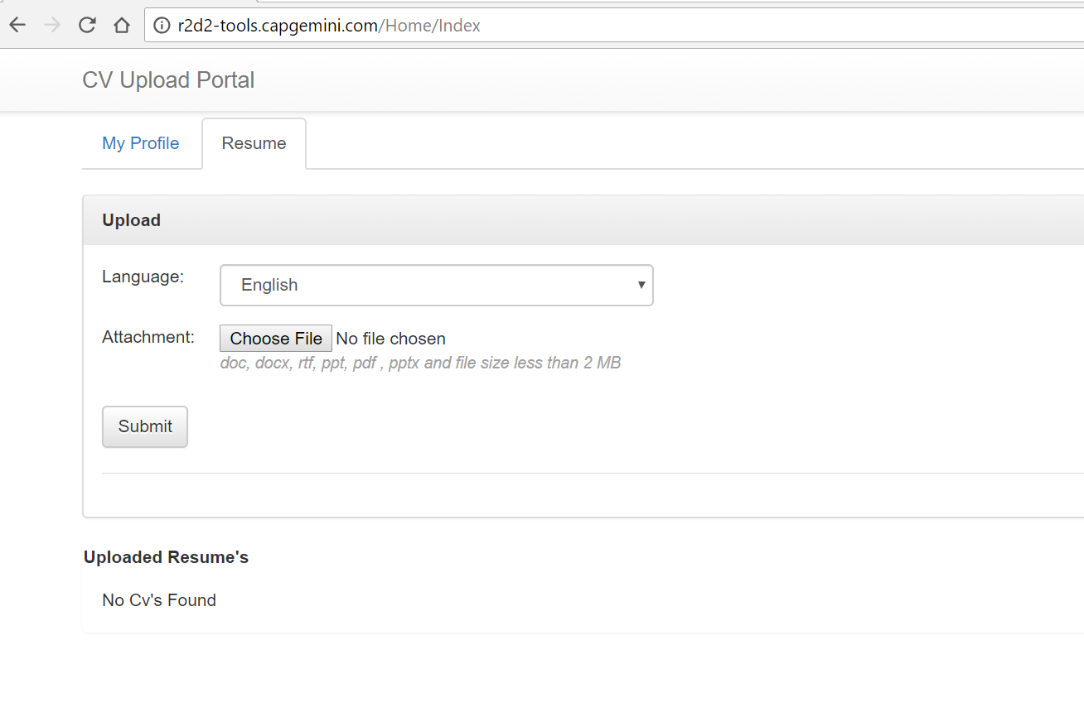
CV Upload
Create your resume using the attached word template. File name should be EmpCode_EN.doc
Open the following url in the Chrome browser to upload your resume in the Skill Portal
http://r2d2-tools.capgemini.com/Home/Index
Enter Language as English
Click on Choose File and select the resume from the directory saved
Click on Submit.

Slide 14
CV Upload
Language should be English
Click on Choose File and select the resume
Click on Submit.

Slide 15




